Slide 1
Digital Audio Signal Processing
DASP
Chapter-4:
Adaptive Beamforming &
Multi-Channel Noise Reduction
Marc Moonen
Dept. E.E./ESAT-STADIUS, KU Leuven
marc.moonen@esat.kuleuven.be
homes.esat.kuleuven.be/~moonen/

Slide 2
Overview
Recap
Adaptive Beamforming
  Adaptive beamforming goal & set-up
  LCMV beamformer
  Generalized sidelobe canceler
Multi-channel Wiener filter for multi-microphone noise reduction (/speech enhancement)
  Multi-microphone noise reduction problem
  Multi-channel Wiener filter (=spectral+spatial filtering)

Slide 3
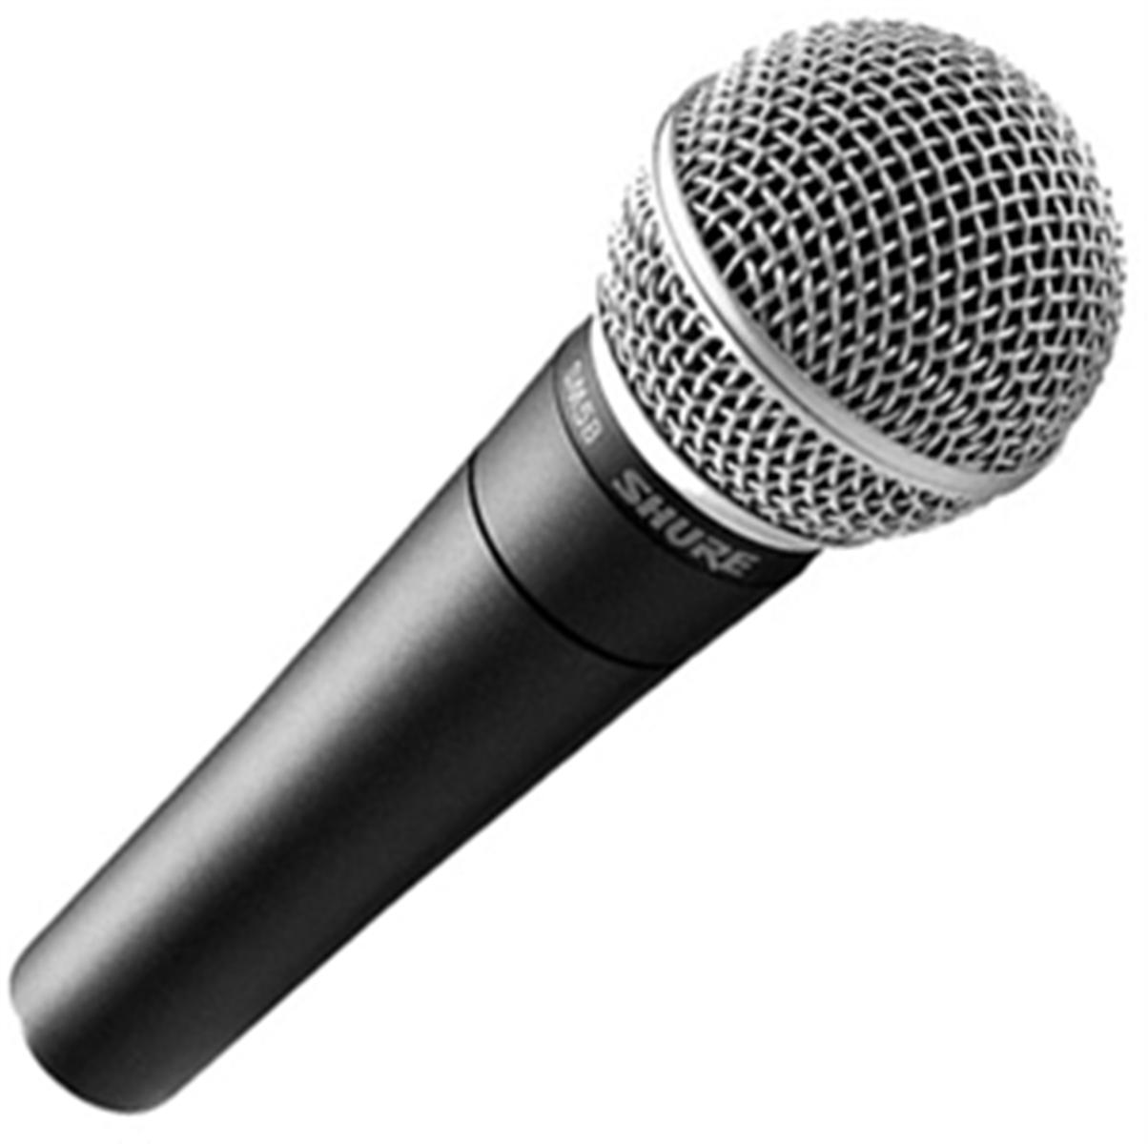
Recap 1/4
Filter-and-sum Beamforming
Classification:
  Fixed beamforming:
  Data-independent, fixed filters F_{m}
  e.g. matched filtering, superdirective, …
  Adaptive beamforming:
  Data-dependent filters F_{m}
  e.g. LCMV-beamformer, generalized sidelobe canceler
+
:
= Previous chapter
= This chapter

Slide 4
Recap 2/4
Data model: source signal
Microphone signals are filtered versions of source signal S(ω) at angle θ
Stack all microphone signals (m=1..M) in a vector
d is `steering vector’

Slide 5
Recap 3/4
Data model: source signal + noise
Microphone signals are also corrupted by additive noise
Noise correlation matrix is
Output signal after `filter-and-sum’ is

Slide 6
Recap 4/4
Definitions:
Array directivity pattern = `transfer function’ for source signal at θ
Array Gain = improvement in SNR for source signal at θ
White Noise Gain
=array gain for spatially uncorrelated noise
Directivity
=array gain for diffuse noise

Slide 7
Overview
Recap
Adaptive Beamforming
  Adaptive beamforming goal & set-up
  LCMV beamformer
  Generalized sidelobe canceler
Multi-channel Wiener filter for multi-microphone noise reduction (/speech enhancement)
  Multi-microphone noise reduction problem
  Multi-channel Wiener filter (=spectral+spatial filtering)

Slide 8
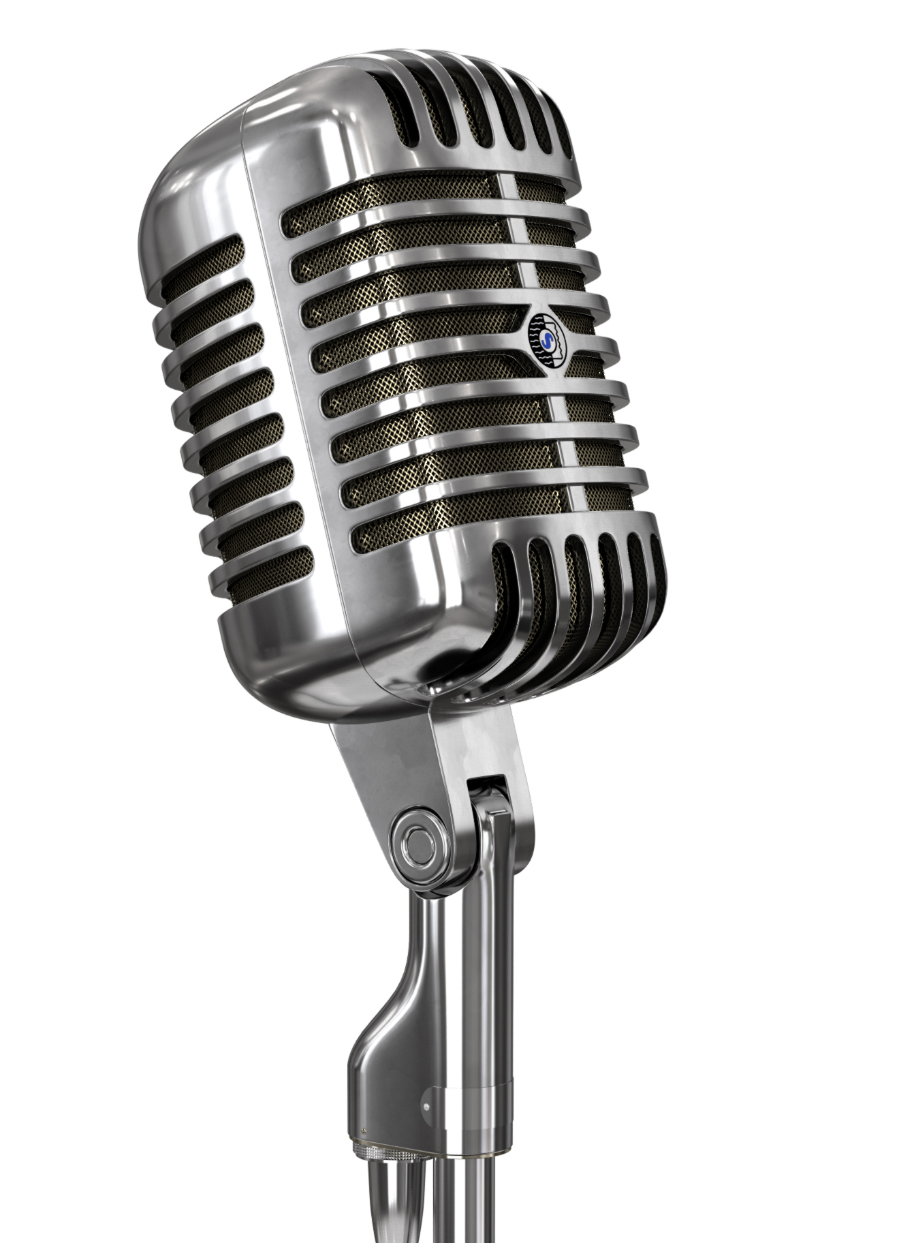
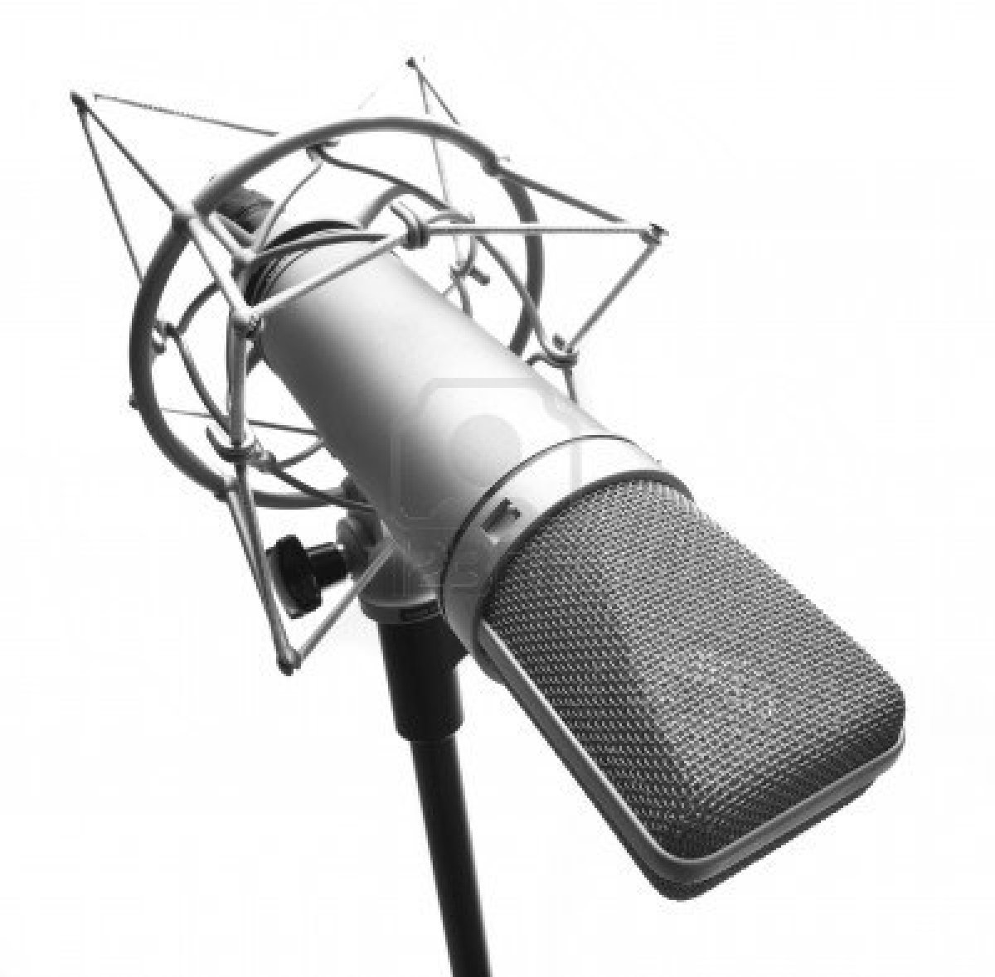
  Adaptive beamforming Goal & Set-up
Adaptive filter-and-sum structure:
  Aim is to minimize noise output power, while maintaining a fixed response for a given angle ψ (=assumed source signal angle) (plus possibly other linear constraints, see below)
  This is similar to the operation of a matched filter beamformer (in white noise) or superdirective beamformer (in diffuse noise) see Chapter-3 (**) p.26 & 36 but now noise field is unknown & adapted to
+
:

Slide 9
  Adaptive beamforming Goal & Set-up
Adaptive filter-and-sum structure:
  Will use (adaptive) FIR filters :
+
:

Slide 10
Overview
Recap
Adaptive Beamforming
  Adaptive beamforming goal & set-up
  LCMV beamformer
  Generalized sidelobe canceler
Multi-channel Wiener filter for multi-microphone noise reduction (/speech enhancement)
  Multi-microphone noise reduction problem
  Multi-channel Wiener filter (=spectral+spatial filtering)

Slide 11
LCMV beamformer
LCMV = Linearly Constrained Minimum Variance
  Minimize (source signal+noise) output power (=‘variance’) z[k] (see ‘Note’) :
  Subject to (J) linear constraints to avoid source signal cancellation
    Example: fix array directivity pattern for angle ψ at J sample freqs ω_{i}
Note: For J➔∞, constrained output power minimization corresponds to constrained noise output power minimization (if source signal angle is equal to ψ). (why?)
Hence, this LCMV formulation is appropriate for cases where R_{yy} can be estimated, while R_{nn} can not be estimated separately.
When the source signal is a speech signal, where R_{nn} is observable during speech pauses, then R_{nn} can be used instead of R_{yy} in the LCMV formulation (see p.21).

Slide 12
LCMV beamformer
LCMV = Linearly Constrained Minimum Variance
  Minimize output power z[k]:
  Subject to (J) linear constraints to avoid source signal cancellation
  Solution is (obtained using Lagrange-multipliers, etc..):
  This can be computed for each time k: first estimate R_{yy}⁻¹[k], etc..
  But would rather have a truly recursive algorithm, see next slides
  PS: Compare to Chapter-3, p.26 & 36 (frequency domain & J=1, R_{nn}⬅➔R_{yy})

Slide 13
Overview
Recap
Adaptive Beamforming
  Adaptive beamforming goal & set-up
  LCMV beamformer
  Generalized sidelobe canceler
Multi-channel Wiener filter for multi-microphone noise reduction (/speech enhancement)
  Multi-microphone noise reduction problem
  Multi-channel Wiener filter (=spectral+spatial filtering)

Slide 14
Generalized sidelobe canceler (GSC)
GSC = Adaptive filter solution for LCMV-problem
Constrained optimisation is reformulated as a constraint pre-processing,
followed by an unconstrained optimisation, as follows:
  LCMV-problem is
  Define `blocking matrix’ C_{a,}, columns spanning the null-space of C
  Define ‘quiescent response vector’ f_{q} satisfying constraints
  Parametrize all f’s that satisfy constraints (verify!)
  i.e. filter f can be decomposed in a fixed part f_{q} and a variable part C_{a.} f_{a}

Slide 15
Generalized sidelobe canceler (GSC)
GSC = Adaptive filter formulation of the LCMV-problem
Constrained optimisation is reformulated as a constraint pre-processing,
followed by an unconstrained optimisation, as follows:
  LCMV-problem is
  Unconstrained optimization of f_{a} :
  (MN-J coefficients)

Slide 16
Generalized sidelobe canceler
GSC (continued)
  Hence unconstrained optimization of f_{a} can be implemented as an
  adaptive filter (adaptive linear combiner), with filter inputs (=‘left-
  hand sides’) equal to and desired filter output (=‘right-hand side’) equal to
  Example: LMS algorithm

Slide 17
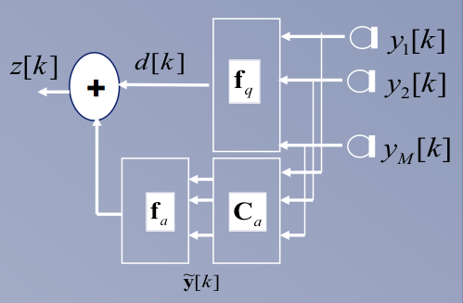
Generalized sidelobe canceler
GSC then consists of three parts:
Fixed beamformer (cfr. f_{q} ), satisfying constraints (‘LC’) but not yet minimum variance (‘MV’) ), creating `source signal reference’
Blocking matrix (cfr. C_{a}), beamformers with null response for angle ψ (at sampling frequencies) (cfr. C’.C_{a}=0), creating MN-J `noise references’
Multi-channel adaptive filter
(linear combiner)
your favourite one, e.g. LMS
PS: = large matrix
complexity O(MN.(MN-J))
even with LMS for f_{a}

Slide 18
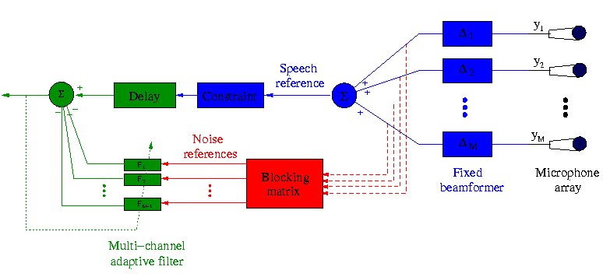
Generalized sidelobe canceler
A popular & cheaper GSC realization is as follows
Note that some reorganization has been done:
The blocking matrix now generates (typically) M-1 (instead of MN-J) noise references.
The multichannel adaptive filter performs FIR-filtering on each noise reference (instead of merely scaling in the linear combiner) (=complexity O((M-1)N) for LMS)
Philosophy is the same, mathematics are different (details on next slide).
y1
ignore
ignore
ignore
Postproc
yM

Slide 19
Generalized sidelobe canceler
A popular & cheaper GSC realization is as follows (continued)
Blocking matrix
  Creating (M-1) independent noise references by means of (M-1) beamformers with null response for angle ψ
  Different possibilities, e.g.
(ψ=90 , i.e. ‘broadside steering’)
Griffiths-Jim
Walsh

Slide 20
Generalized sidelobe canceler
Math details: (ψ=90 , i.e. ‘broadside steering’)
select `sparse’ blocking matrix such that :
=input to multi-channel adaptive filter
=use this as blocking matrix now

Slide 21
Generalized sidelobe canceler
Problems of GSC:
  Impossible to reduce noise from angle ψ (cfr. constraint)
  If steering vectors d(ω_{i},ψ) (see p.11) are not accurately known (e.g. due to inaccurate source position or reverberation), will have source signal ‘leakage’ into noise references, which can lead to source signal cancellation by the adaptive filter.
  Therefore, to avoid source signal cancellation, adaptive filter should
  only be updated when no source signal is present
  (i.e. in noise-only periods).
  In speech applications, this is done with a
  voice activity detection (VAD).
  Effectively, this corresponds to replacing R_{yy} by R_{nn} in p.11 (and
  following slides)

Slide 22
Overview
Recap
Adaptive Beamforming
  Adaptive beamforming goal & set-up
  LCMV beamformer
  Generalized sidelobe canceler
Multi-channel Wiener filter for multi-microphone noise reduction (/speech enhancement)
  Multi-microphone noise reduction problem
  Multi-channel Wiener filter (=spectral+spatial filtering)

Slide 23
Multi-Microphone Noise Reduction Problem
compare to Chapter-2
speech source
?
(some) speech estimate
microphone signals
noise source(s)
M= number of microphones
speech part
noise part

Slide 24
Multi-Microphone Noise Reduction Problem
Will estimate speech
part in microphone 1
(*) (**)
?
(*) Estimating s[k] is more difficult, would include dereverberation
(**) This is similar to single-microphone model (Chapter-2), where additional
microphones (m=2..M) help to get a better estimate

Slide 25
Multi-Microphone Noise Reduction Problem
Data model:
(frequency domain)
See Chapter-3 on multi-path propagation (with q left out for conciseness)
H_{m}(ω) is complete transfer function from speech source position to m-the microphone
No prior knowledge assumed here!

Slide 26
Overview
Recap
Adaptive Beamforming
  Adaptive beamforming goal & set-up
  LCMV beamformer
  Generalized sidelobe canceler
Multi-channel Wiener filter for multi-microphone noise reduction (/speech enhancement)
  Multi-microphone noise reduction problem
  Multi-channel Wiener filter (=spectral+spatial filtering)

Slide 27
Multi-Channel Wiener Filter (MWF)
Data model:
Will use linear filters to obtain speech estimate
Wiener filter (=linear MMSE approach)
Note that (unlike in DSP-CIS) `desired response’ signal S1(w) is unknown here (!)

Slide 28
Multi-Channel Wiener Filter (MWF)
Wiener filter solution is (see DSP-CIS)
  All quantities can be estimated !
  Special case of this is single-channel Wiener filter formula (Chapter-2)
  In practice, use alternative to ‘subtraction’ operation (see slide 32)
compute during speech+noise periods
compute during noise-only periods

Slide 29
Multi-Channel Wiener Filter (MWF)
MWF combines spatial filtering with
single-channel spectral filtering (as in Chapter-2) :
if
then…

Slide 30
Multi-Channel Wiener Filter (MWF)
…then it can be shown that
represents a spatial filtering (*)
  Compare to superdirective & matched filter beamforming (Chapter-3)
  Matched filter beamf. maximizes array gain in white noise field
  Superdirective beamf. maximizes array gain in diffuse noise field
  MWF maximizes array gain in unknown (!) noise field.
  MWF is operated without invoking any prior knowledge (steering
  vector/noise field) ! (the secret is in the voice activity detection… (explain))
(*) Note that spatial filtering can improve SNR, spectral filtering never improves SNR
(at one frequency)

Slide 31
Multi-Channel Wiener Filter (MWF)
…then it can be shown that
represents a spatial filtering (*)
represents an additional spectral ‘post-filter’
  i.e. single-channel Wiener estimate of S₁(ω) (Chapter-2 p.9) applied to output signal of spatial filter (...prove it!)

Slide 32
Multi-Channel Wiener Filter (MWF)
Correlation matrices
  are estimated in each frame by averaging over a number of previous frames, possibly with exponential weighting, i.e.
Update in speech+noise frames
Update in noise-only frames

Slide 33
Multi-Channel Wiener Filter (MWF)
Note that (in the above formula)
is a positive-definite rank-1 matrix, whereas (with estimated matrices)
is generally not rank-1, and often not positive-definite
Hence
generally provides a poor filter estimate..

Slide 34
Multi-Channel Wiener Filter (MWF)
A better procedure (v1.0) could be as follows
where ϕ_{speech} is a rank-1 matrix estimated (in each frame) as

Slide 35
Multi-Channel Wiener Filter (MWF)
An even better procedure (v2.0) is as follows
where ϕ_{speech} is a rank-1 matrix estimated (in each frame) as
which now also includes a ‘noise whitening’ operation
(making the estimation also immune to, for instance, scalings of the microphone signals)

Slide 36
Multi-Channel Wiener Filter (MWF)
Solution is (for v2.0) is based on
Generalized Eigenvalue Decomposition
of matrix pair {ϕ^_{s&n,} ϕ^_{noise}} :
a.k.a
‘joint diagonalization’

Slide 37
Multi-Channel Wiener Filter (MWF)
With this ϕ_{speech} (in v2.0) becomes (proof omitted)
and then
PS: If k^{th} microphone is reference microphone (instead of 1st microphone, see page 24) then first line has e_{k}, last line has [Q^{H}]_{1k} and e₁

Slide 38
Multi-Channel Wiener Filter (MWF)
Scalar is representative of spectral filtering:
Compare with spectral subtraction formulas…
Eigenvalues (σ_{s&n}/σ_{noise}) represent signal-to-noise ratios
Eigenvector is representative of spatial filtering:
Compare to p.30-31

Slide 39
Multi-Channel Wiener Filter: Implementation
Implementation with short-time Fourier transform (see Chapter-2)
Implementation with time-domain FIR filtering:
filter
coefficients

Slide 40
Multi-Channel Wiener Filter: Implementation
Solution is…
Implementation with time-domain linear filtering:
compute during speech+noise periods
compute during noise-only periods

